Slide 1

IBM Professional certificate: Specialized Models: Time Series and Survival Analysis
Ibrahim Mohamed
October 2022

Slide 2
Main objective
This analysis' primary goal is to explore a dataset of light weight vehicle sales in USA from 1976 to 2022 using time series techniques, in order to forecast the sales for future periods to help the owners of lightweight vehicles showrooms in USA to draw conclusions and insights and make right decision of their business

Slide 3
About the data
This dataset is downloaded from U.S. Bureau of Economic Analysis.
It has a lable of Light Weight Vehicle Sales (LTOTALNSA)
Its release is Supplemental Estimates, Motor Vehicles
Frequency: Monthly
Units: Thousands of Units, Not Seasonally Adjusted

Slide 4
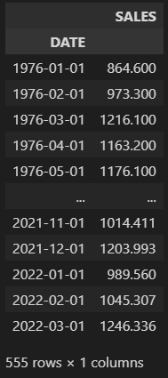
Data exploration
Features:
The dataset consists of two columns:
DATE
LTOTALNSA (relabeled to “SALES”)
DATE : contains monthly dates from 1976 – 2022
For instance: 1976-04-01 (YYYY-MM-DD)
SALES: contains monthly light weight vehicle sales in thousands of units
For instance : 1163.2 thousand of vehicle (1163200 units) are sold in this date.
Number of records :
555 rows

Slide 5
Exploratory data analysis
Methodology
We are going to apply different tests & analysis to check each of :
White Noise:
Time series can be considered as white noise (can’t be modeled for forecasting) if it satisfies three conditions :
Approximately zero mean over the time series.
Constant standard deviation over the time series.
Specific patterns in the correlations between the time series and its lags.
Stationarity:
In order a time series data to be stationary, the data must exhibit four properties over time:
constant mean
constant variance
constant autocorrelation structure
no periodic component

Slide 6
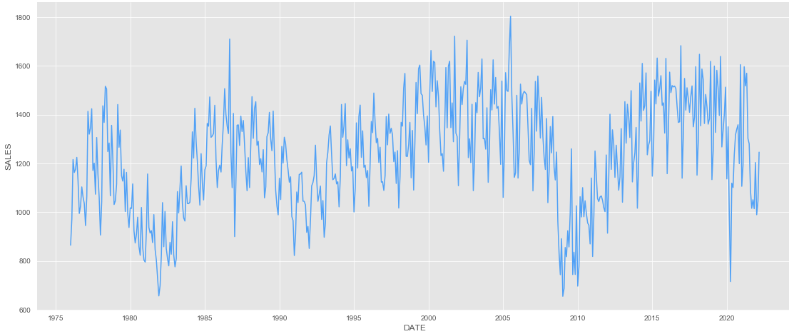
Exploratory data analysis
Visualization & General Features
we can extract from the graph the following features:
There is no trend in other words Stationary trend which indicates a constant mean.
The variance is constant.
The graph does not show a periodic component (no seasonality)
LTOTALNSA Timeseries Visualization

Slide 7
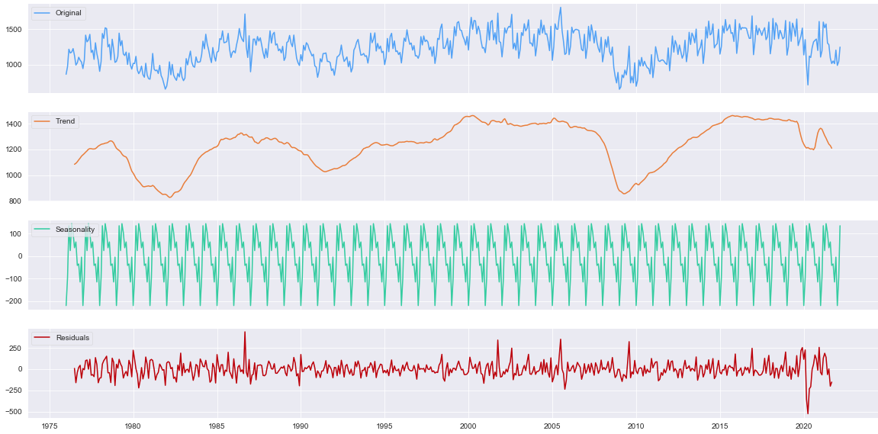
Exploratory data analysis
Decomposition
The decomposition model estimates the existence of a seasonality or a seasonal component, but this doesn’t mean it has one (it is better to extract the seasonality from the original series in the cyan color).
Stationary trend
Additive Seasonality

Slide 8
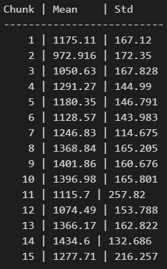
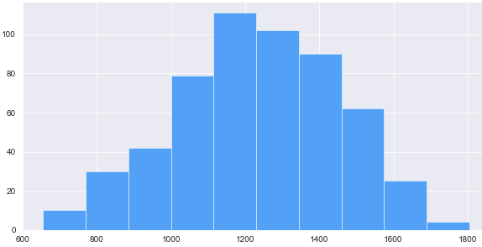
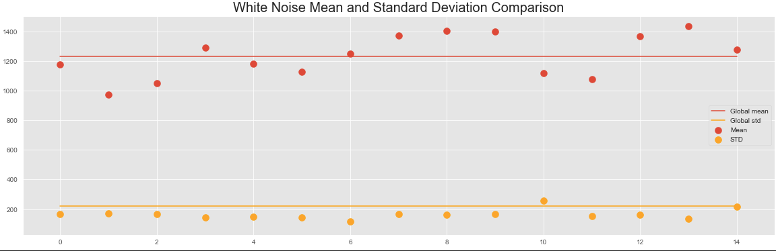
Exploratory data analysis
Mean & Standard Deviations
As shown all chunks have approximately closed mean values where they range between 1100 & 1400 (non-zero mean) which refers to a time series does not behave as white noise, standard deviations range mostly between 140 & 160 with existence of a little bit of variance.

Slide 9
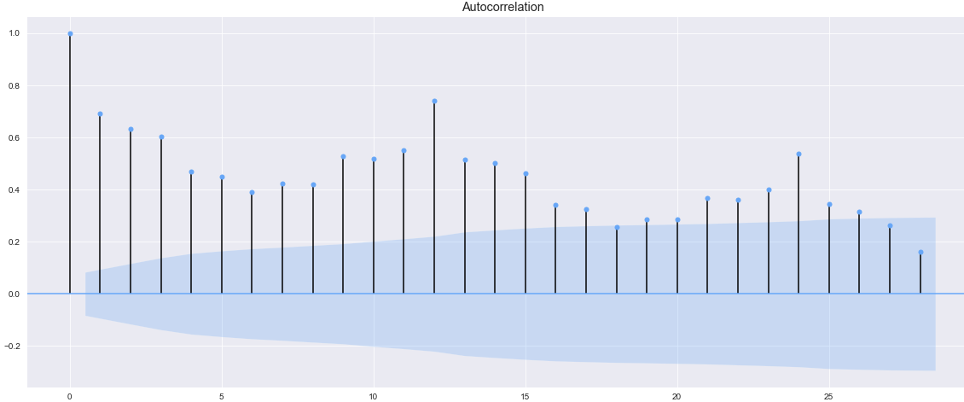
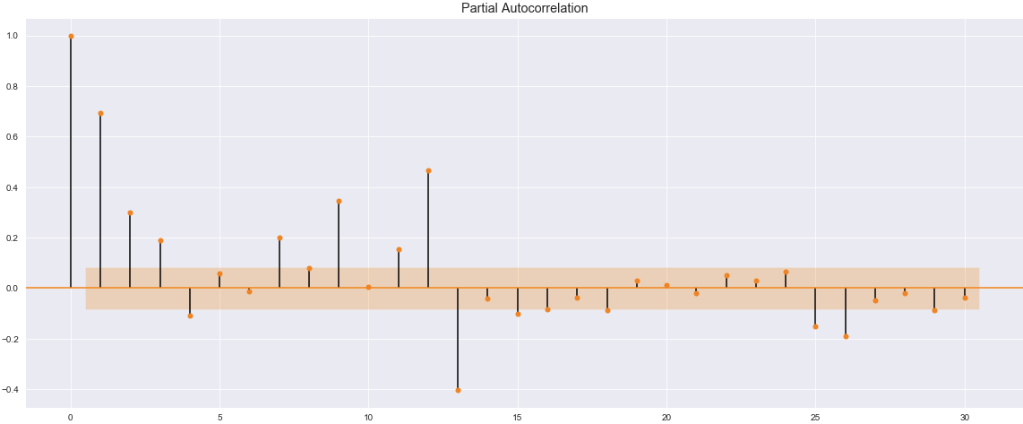
Exploratory data analysis
Autocorrelation plots & Partial Autocorrelation plot
As shown in the plot to the side the most majority of the correlations between the time series lags are statistically significant since it is out of the confidence interval (shaded area), and they are decreasing gradually.
We have a moderate correlation between original time series and lag 12

Slide 10
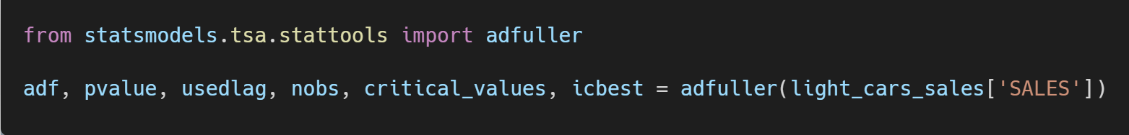
Exploratory data analysis
Augmented Dickey-Fuller Test
This is a statistical procedure to discover whether a time series is stationary or not.
We won't go into all the nitty gritty details but here's what you need to know:
Null hypothesis: the series is nonstationary.
2. Alternative hypothesis: the series is stationary.
Like any statistical test you should set a significance level or threshold that determines whether you should accept or reject the null.
The value 0.05 is common but depends upon numerous factors.

Slide 11
Exploratory data analysis
Augmented Dickey-Fuller Test
adf = -2.829277524541586
First, adf is the value of the test statistic. The more negative the value, the more confident we can be that the series is stationary. Here we see a value of -2.83. That may not mean anything to you just yet, but the p-value should.
A brief discussion about the important outputs from the ADF test is in order.
Pvalue = 0.05421184907221919
p-value is interpreted like any p-value. Once we set a threshold, we can compare this p-value to that threshold. Either we reject or fail to reject the null. Here p-value is very close to zero “0.054” so we reject the null that this data is nonstationary, and we can conclude that it is a stationary time series.
critical_values = {'1%': -3.442609129942274, '5%': -2.866947348175723, '10%': -2.569649926626197}
Finally, the critical_values variable provides test statistic thresholds for common significant levels. Here we see a test statistic of roughly -2.86 and lower is sufficient to reject the null using a significance level of 5%.

Slide 12
Exploratory data analysis
Summary
White Noise:
Time series can be considered as white noise (can’t be modeled) if it satisfies three conditions :
Approximately zero or exactly zero mean over the time series. [not satisfied]
Constant standard deviation over the time series. [satisfied]
correlations between the time series and its lags are not statistically significant. [not satisfied]
Final Decision: Time series is not considered a white noise.
Stationarity:
In order a time series data to be stationary, the data must exhibit four properties over time:
constant mean [satisfied]
constant variance [satisfied]
constant autocorrelation structure [satisfied]
no periodic component [satisfied]
Final Decision: Time series is considered stationary.

Slide 13
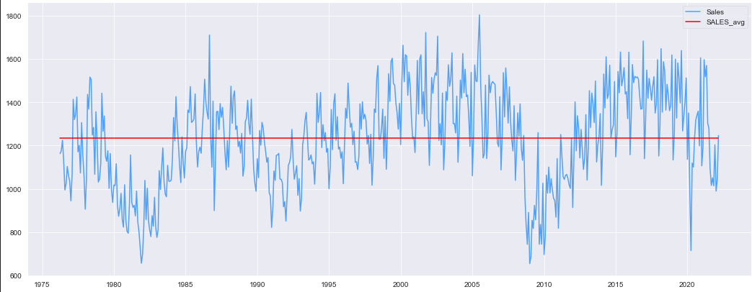
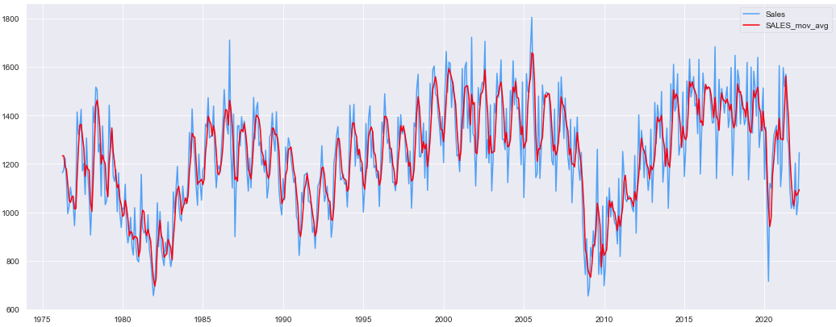


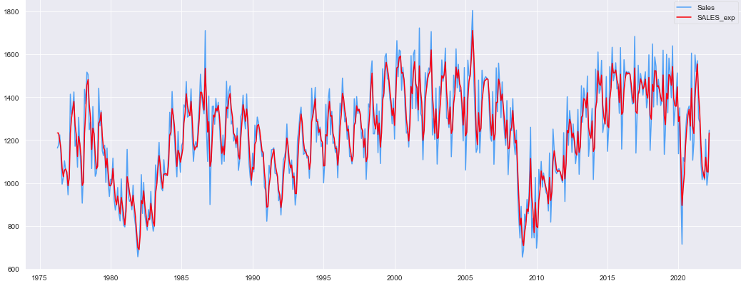

Exploratory data analysis
Feature Engineering
Smoothing Time Series
1- Simple Smoothing
2- Moving Average Smoothing
3 - Exponential Smoothing

Slide 14
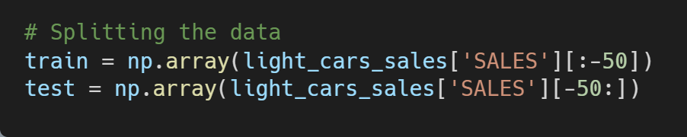
Exploratory data analysis
Forecasting using Smoothing
Training set : 502 observations.
Testing set : 50 observations

Slide 15
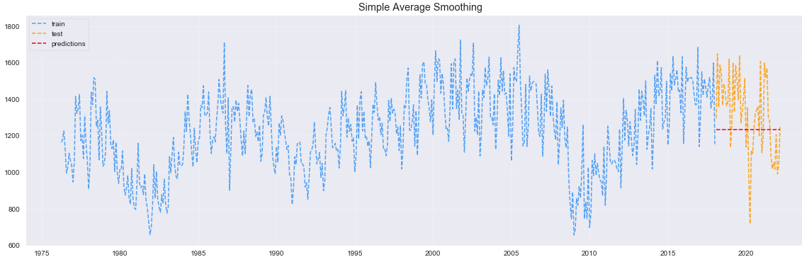
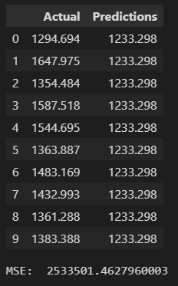
Machine learning analysis
Forecasting by Simple Average
There is a high error between the predictions and actual values.
Mean Square Error : 2533501

Slide 16
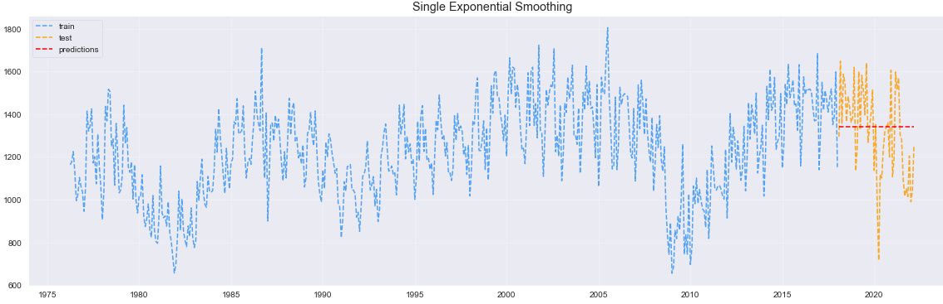
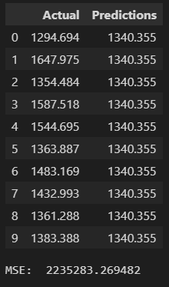
Machine learning analysis
Forecasting by Single Exponential
The results enhanced a little bit, but as the same time, we can see a high error relatively between the predictions and actual values.
Mean Square Error : 2235283

Slide 17
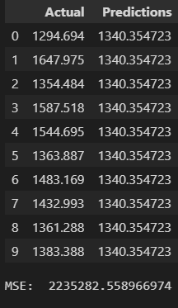
Machine learning analysis
Forecasting by Triple Exponential
Triple exponential technique achieved the same result of single exponential smoothing technique.
Mean Square Error : 2236924

Slide 18
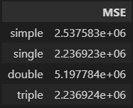
Machine learning analysis
Comparison
The DataFrame on the right illustrates that single and triple exponential forecasting produced the best results, while double exponential smoothing produced the worst results. However, all of these forecasting techniques are regarded as unreliable because they resulted in extremely high error; in the following slides, we will use better forecasting models and techniques.

Slide 19
Machine learning analysis
Autocorrelation to choose appropriate model
SHAPE | MODEL
Exponential Decaying to zero | AR models
Alternating positive and negative decaying to zero | AR models
One or more spikes, the rest are close to zero | MA model
Decay after a few lags | Mixed AR and MA
All zero or close to zero | Data is random
High values at fixed intervals | Include seasonal AR term
No decay to zero | Series is not stationary

Slide 20
Machine learning analysis
Using SARIMA model for forecasting.
If the series exhibits positive autocorrelations out to a large number of lags, then a higher degree of differencing is likely necessary. The series does not require a higher level of differencing if the lag-1 autocorrelation is zero, negative, or all tiny and pattern-less. The series may be over-differenced if the lag-1 autocorrelation is -0.5 or higher negative.
An undifferentiated model presupposes that the initial series is steady (mean-reverting). A model with one order of differencing considers the original series' average trend to be constant (e.g. a random walk or SES-type model, with or without growth). According to a model with two orders of total differencing, the original series exhibits a trend that changes with time (e.g. a random trend or LES-type model).

Slide 21
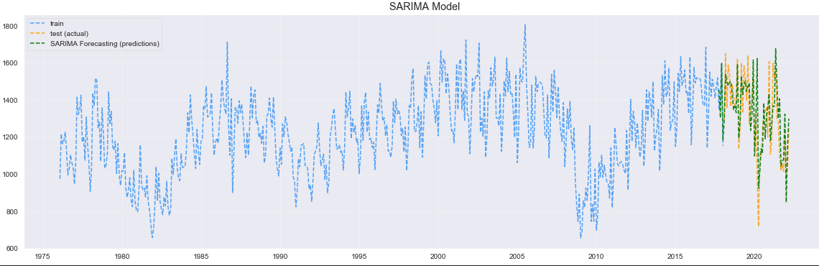
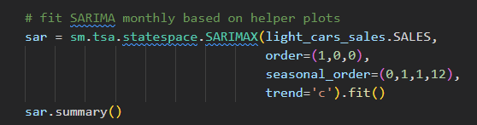

Machine learning analysis
Forecasting using SARIMA model
Predications from this model is better than the smoothing ones, it’s actually near half od them
Mean Square Error : 1085655

Slide 22
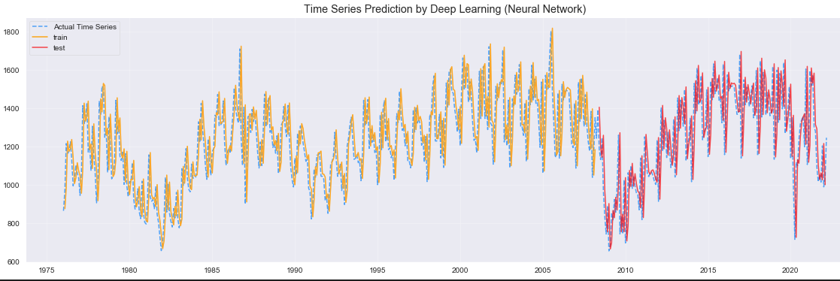

Machine learning analysis
Neural Network Prediction
Predications from this model is better than the smoothing ones, it’s actually near half od them
Mean Square Error : 1085655

Slide 23
Machine learning analysis
Models Strengths and Flaws:
Time series modelling and forecasting is typically regarded as one of the most difficult problems to approach in data science because it necessitates a significant amount of analysis and work. As demonstrated in the previous slides, we exposed to several techniques and compared them in terms of forecasting; the forecasting by smoothing technique produced the worst results but gave us the impression that the time series could be predicted by more sophisticated techniques.

Slide 24
Analysis Next Steps
Further suggestions
In terms of modelling and predicting time series, deep learning models produced the greatest results. By utilising more sophisticated approaches, such as
Recurrent Neural Networks (RNN)
Long Short-Term Memory. (LSTM)

